Slide 1
How to Complete Partisan Nomination Petition & Declaration of Qualification

Slide 2
Signing Petitions
The signer must live in your precinct and must be a Registered Republican.
The signer needs to make sure they’re registered as a Republican per BeBallotReady.Vote.
Signer must live at the address they’re registered.
Print the Partisan Nomination Petition with Landscape orientation – it doesn’t matter whether the back side is copied the same direction as the front side.
Please give signer direction on each block of the line before you hand them the Petition.
Make sure signer knows what to write in each block of the line.
First Block is their signature as they are registered to vote.
Second Block – Print their name as registered.
Third Block – Residence Address and City or Town – State and Zip Code are not necessary.
Fourth Block – Date Petition was signed usually with this format - 3/12/24 (make sure they stay within the block).
Get at least 12 signatures, try to get 15 if possible. You’ll need to complete 2 Nomination petitions.
Nomination Petition and Declaration of Candidacy must be delivered to Maricopa County Elections office prior to April 1, 2024. You MUST make an appointment to deliver the petitions.
Another PC, or others may take your paperwork to the Maricopa County Elections Office. Arrange with others to deliver Petition & Declaration to Elections office by the second or third week of March if possible.

Slide 3
Change Grand precinct to your Precinct – this is only a sample!

Slide 4
Top of Partisan Nomination Petition – Front Side
The 4 boxes must contain:
county of Maricopa and of YOUR Precinct / LD#29
member of Republican nominate YOUR NAME

Slide 5
Top of Partisan Nomination Petition Front Side - Continued
The 4 boxes must contain:
resides at Your current address county of Maricopa
office of Precinct Committeeman be held 7/30/2024

Slide 6
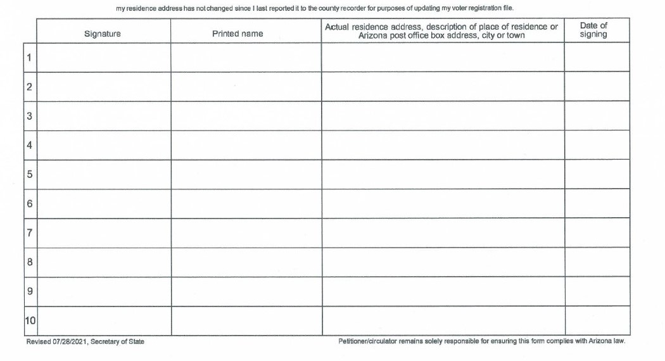

Slide 7
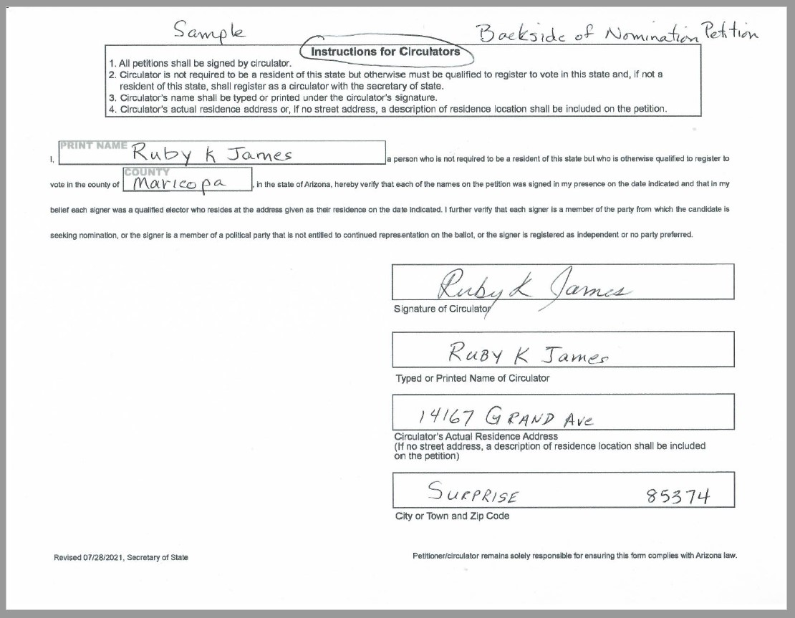
Back Side of Partisan Nomination Petition – Instructions for Circulators

Slide 8
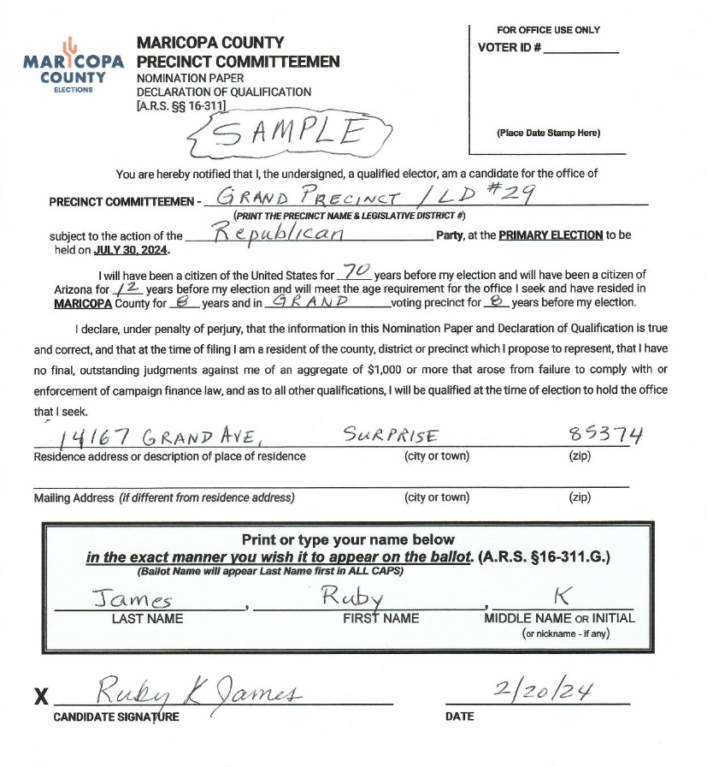

Slide 9
Ctrl+Click the link below for
Fillable PDF
PC Nomination Forms,
Petitions and Declarations
https://maricopagop.org/sign-up-as-a-pc/

